Slide 1


SINGLE & MULTI OBJECTIVE OPTIMIZATION
FOR SOLVING REAL WORLD PROBLEMS
Final Review
Major Project
Project ID: CS5
AY 2021-25
GITAM (Deemed-to-be) University
Project Team:
D Hafeez –BU21EECE0100213
V Varun Sai- BU21EECE0100108
U Pavani – BU21EECE0100474
Department of Electrical Electronics and Communication Engineering
Project Mentor:
Dr. Avishek Chakraborthy
Project In-charge:
Dr Rohan Prasad
www.gitam.edu

Slide 2
Objective and Goals
Objective
The objective of this project is to develop and implement bio-inspired optimization algorithms for the design and optimization of linear and circular antenna arrays, enhancing their performance for modern communication systems. The focus is on achieving high directivity, low sidelobe levels, and optimized beamforming, which are critical for applications such as 5G networks, radar systems, and satellite communications.
This study leverages Particle Swarm Optimization (PSO), Harmony search Algorithm(HS) and Firefly Algorithm (FA) to achieve superior array performance while ensuring computational efficiency and adaptability for real-world deployment.
Goals
Minimize Sidelobe Levels (SLL) – Reduce unwanted radiations to improve signal clarity and interference suppression. Maximize Directivity – Enhance the antenna's ability to focus energy in a desired direction. Optimize Beamforming – Improve signal steering precision for better communication efficiency.
Algorithm Performance Benchmarking – Compare PSO, GA, and FA in terms of computational complexity and convergence rate.
By achieving these goals, this project aims to contribute to the development of more efficient, adaptive, and high-performance antenna arrays, paving the way for advancements in modern wireless communication technologies.

Slide 3
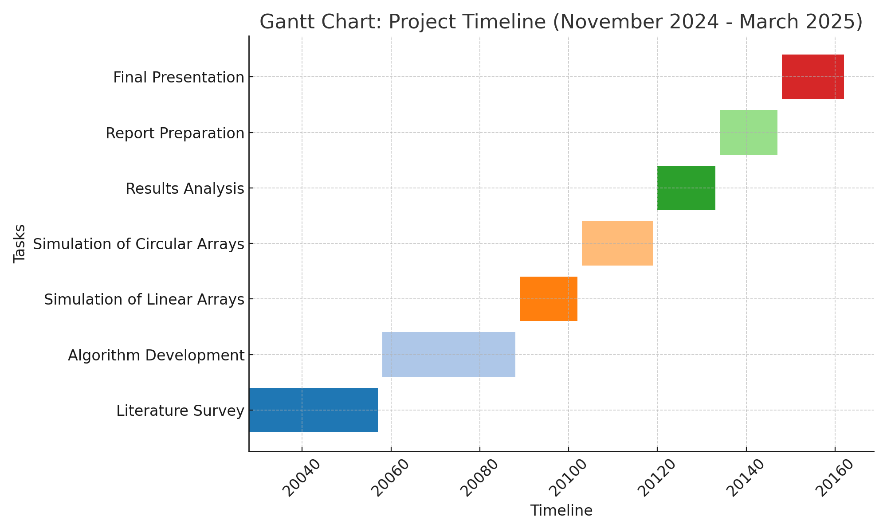
Project Plan (Clearly mention milestone for objectives under each reviews)
Gant Chart - Milestones and Activities
November
December
January
February
March

Slide 4
Literature Survey (Improved post minor project)
Key Publications
Title | Year | Author/s | Technology used
Bio-inspired computation: Where we stand and what’s next | 2019 | Javier Del Ser , Eneko Osaba , Daniel Molina , Xin-She Yang , Sancho Salcedo-Sanz , David Camacho, Swagatam Das, Ponnuthurai N. Suganthan, Carlos A. Coello Coello, Francisco Herrera | Neural Networks
A methodology to find the elementary landscape decomposition of combinatorial optimization problem | 2011 | F. Chicano, L.D. Whitley, E. Alba. | Mathematical Analysis and Algebra Optimization Techniques Machine Learning
No Free Lunch theorems: limitations and perspectives of metaheuristics, in Theory and Principled Methods for the Design of Metaheuristics | 2014 | C. Igel | Metaheuristic Design and Adaptation Theoretical Frameworks and Models Machine Learning
4

Slide 5
Literature Survey (Improved post minor project)
Key Publications
Title | Year | Author/s | Technology used
Robust optimization – A comprehensive survey | 2007 | Hans-Georg Beyer , Bernhard Sendhoff | Mathematical Programming Metaheuristics Decision Support Systems
Data-driven robust optimization | 2018 | Dimitris Bertsimas, Vishal Gupta, Nathan Kallus | Mathematical Programming Metaheuristics Decision Support Systems
Design optimization of linear arrays and time-modulated antenna arrays using meta-heuristics approach | 2021 | Suman Poddar | Prajat Paul | Avishek Chakraborty | Gopi Ram | Durbadal Mandal | Metaheuristics Antenna analysis Communication
5

Slide 6
Architecture
FlowChart
Single and Multi-object optimization
Literature
Survey
Problem Detection
(Linear and circular )
Model Selection
no
Optimization and Solution Generation
SINGLE AND MULTI-OBJECTIVE OPTIMIZATION FOR REAL WORLD PROBLEMS
yes
Validation and Sensitivity Analysis
no
yes
Implementation and Evaluation
Final Report
6

Slide 7
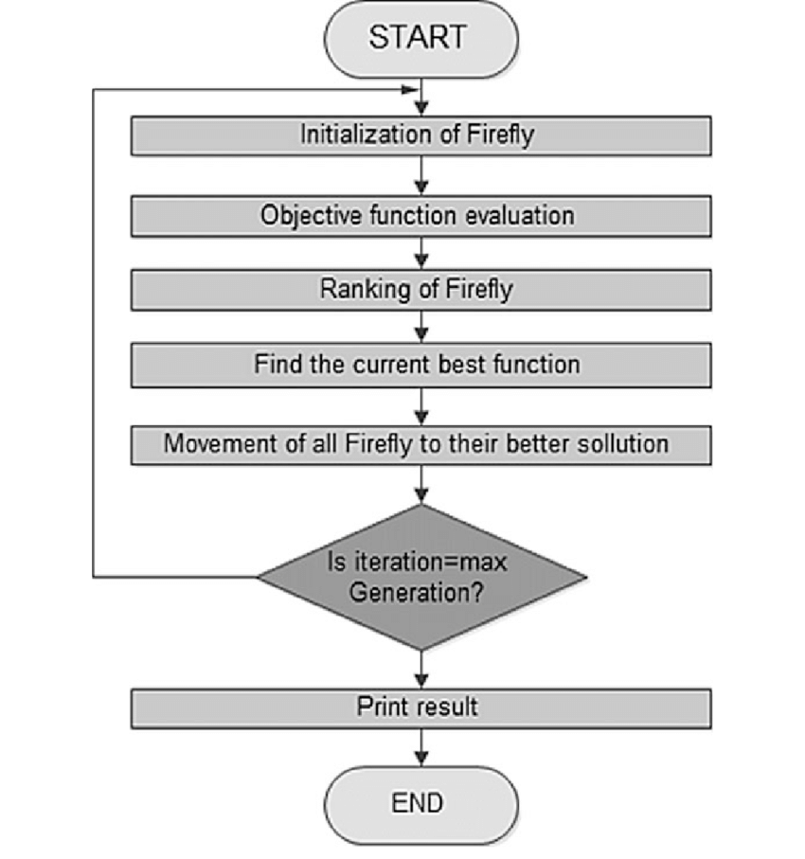
Firefly Algorithm (FA)
The Firefly Algorithm (FA) is a metaheuristic optimization technique inspired by the flashing behavior of fireflies. It was introduced by Xin-She Yang in 2008 and is widely used for solving complex optimization problems.
Working Principle
Initialize the population of fireflies randomly.
Evaluate the fitness function to determine the brightness of each firefly.
Move fireflies toward brighter ones using the attraction formula.
Update positions to explore the search space.
Repeat the process until the stopping criterion is met.

Slide 8
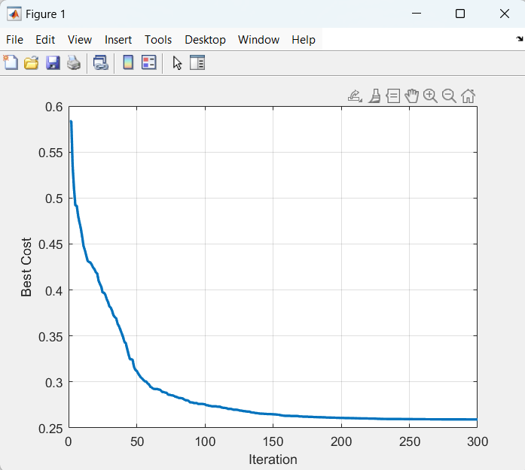
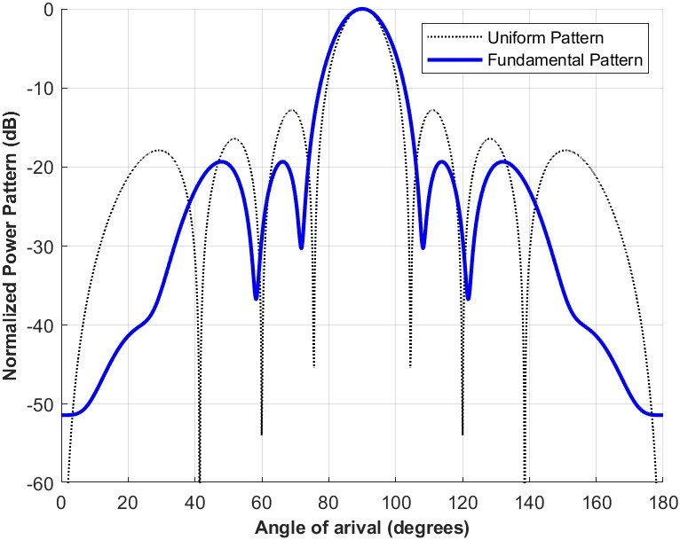
Implementation and Results – FIREFLY algorithm

Slide 9
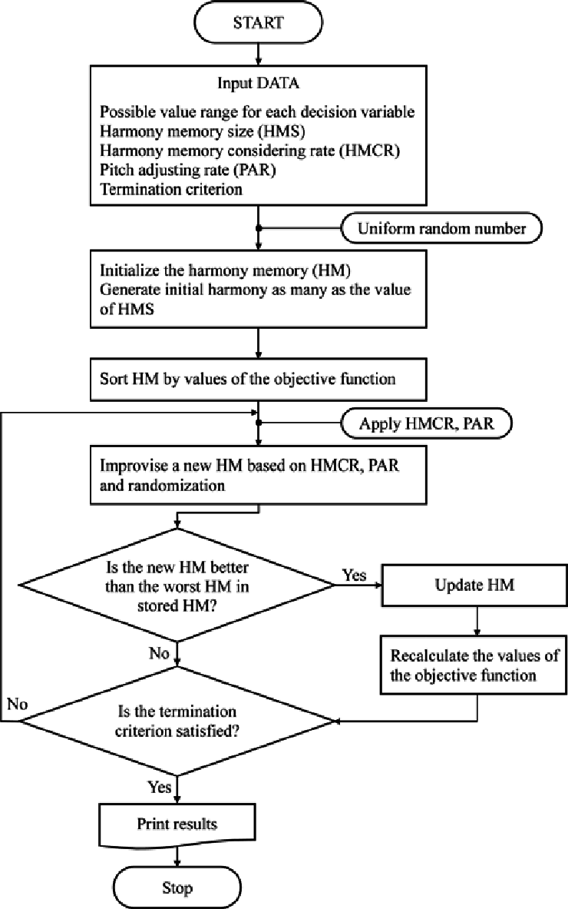
Harmony Search Algorithm (HS)
Harmony Search (HS) is an optimization algorithm inspired by musical improvisation, where musicians adjust their notes to achieve harmony. It was introduced by Zong Woo Geem in 2001 and is effective for combinatorial and continuous optimization problems.
Working Principle
Initialize harmony memory with randomly generated solutions.
Generate a new harmony by considering:
Memory consideration: Choosing a solution from harmony memory.
Pitch adjustment: Slightly modifying a chosen solution.
Random selection: Generating a completely new solution.
Evaluate the fitness of the new harmony.
Update harmony memory by replacing the worst solution if the new harmony is better.
Repeat until the stopping condition is met.

Slide 10
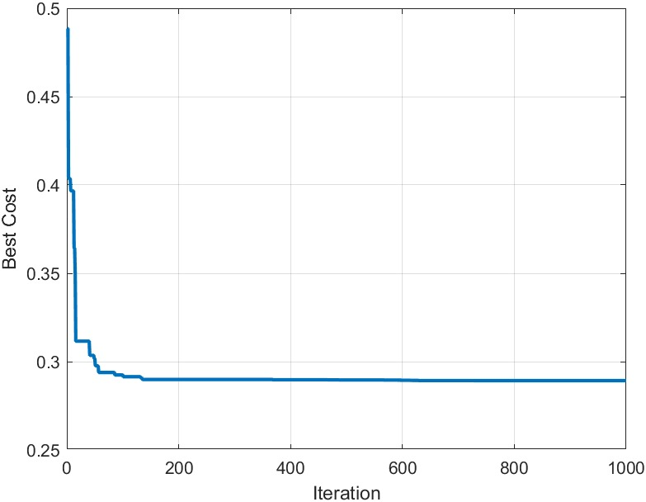
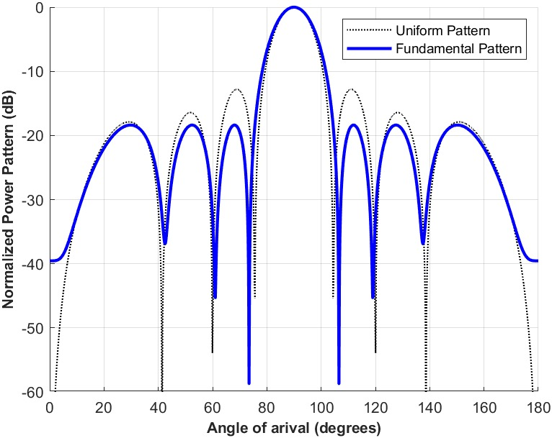
Implementation and Results – Harmony Search algorithm

Slide 11
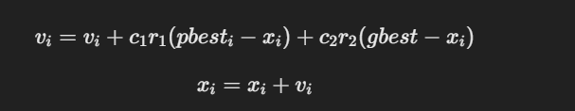
Particle Swarm Optimization (PSO)
Particle Swarm Optimization (PSO) is a nature-inspired optimization algorithm based on the social behavior of birds and fish. It was developed by James Kennedy and Russell Eberhart in 1995 and is widely used in various optimization domains.
Working Principle
Initialize a set of particles with random positions and velocities.
Evaluate the fitness function for each particle.
Update personal best (pbest) and global best (gbest) based on fitness values.
Modify velocity and position using the equations:
Repeat until the termination criterion is met.

Slide 12
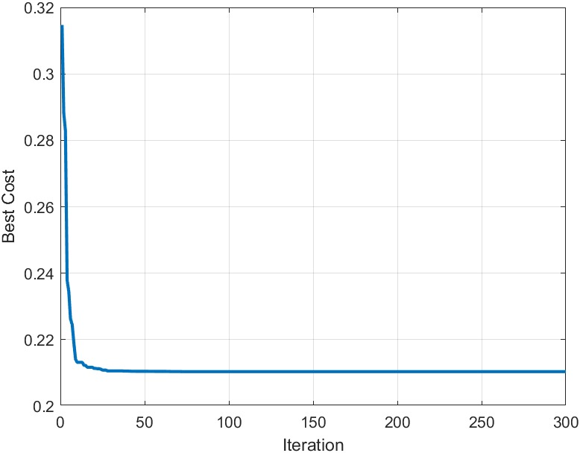
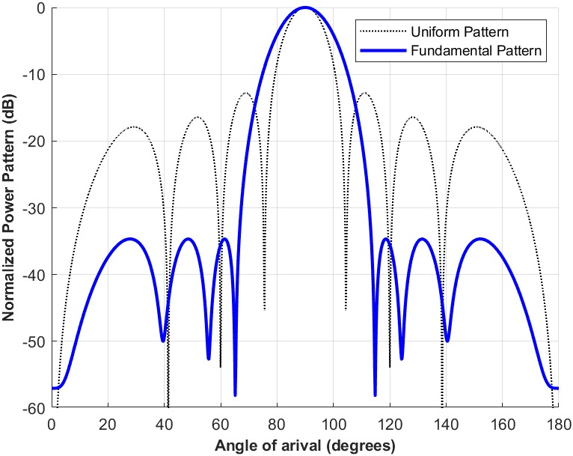
Implementation and Results – PSO

Slide 13
Contribution
Team Progress and Movement
The team has made significant progress in implementing bio-inspired optimization algorithms (PSO, Harmony search, and Firefly Algorithm) for antenna array design. The key milestones achieved so far include:
Literature Survey: Conducted an in-depth study on single and multi-objective optimization techniques.
Problem Definition: Identified key performance metrics (sidelobe reduction, directivity, and beamforming).
Algorithm Selection: Chose PSO, HS, and FA for optimization based on their efficiency and applicability.
Implementation: Successfully implemented and tested algorithms for linear antenna arrays.
Results Evaluation: Conducted sensitivity analysis and validation of results.
The team has adhered to the project plan and milestones, ensuring systematic execution of each phase.
Individual Contribution
1. D. Hafeez
Led the literature survey on bio-inspired optimization algorithms.
Implemented the Particle Swarm Optimization (PSO) algorithm for array beamforming.
Conducted sensitivity analysis to assess the robustness of PSO.
Managed presentation design and final report formatting.
2. V. Varun Sai
implemented the Firefly Algorithm (FA) for antenna array optimization.
Conducted performance evaluation and compared FA results with other algorithms.
refined the code structure for optimization models.
Assisted in validating and optimizing simulation results.
Assisted in report writing, Template, and documentation of findings.
3. U. Pavani
Focused on the Harmony search algorithm(HS) implementation for antenna optimization.
Conducted data visualization and result interpretation for performance analysis.
Assisted in report writing and documentation of findings.
Project Mentor: Dr. Avishek Chakraborthy
Provided guidance on algorithm selection and implementation strategies.
Reviewed the optimization framework and experimental design.

Slide 14
Conclusion & Future Work
Summary and Conclusion
This project focuses on the application of bio-inspired optimization algorithms to enhance the performance of antenna arrays in communication systems. The primary objectives include minimizing sidelobe levels, maximizing array directivity, and improving beamforming accuracy.
Through research and implementation, we have demonstrated the effectiveness of PSO, HS, and Firefly Algorithm in optimizing antenna arrays. Initial results indicate significant improvements in beamforming capabilities and sidelobe suppression.
The study highlights the potential of these algorithms in real-world communication applications, making them viable solutions for next-generation antenna systems.
Future Work
While the current study has successfully applied and evaluated optimization techniques, there are several directions for future improvements:
Scalability: Extend the optimization framework to handle large-scale antenna arrays.
Hybrid Optimization: Combine multiple optimization techniques to enhance performance further.
Hardware Implementation: Validate the results using real-world antenna systems.
Multi-Objective Optimization: Extend the framework to simultaneously optimize multiple conflicting objectives.

Slide 15
THANK YOU
Have a Great Day !

